Slide 1
Text Mining
Instructor: Dr. Atif Khan

Slide 2
ZeroR
●
ZeroR is the simplest classification method which relies on the target and ignores all predictors.
ZeroR classifier simply predicts the majority category (class)
Although there is no predictability power in ZeroR, it is useful for determining a baseline performance as a benchmark for other classification methods
How it works
Construct a frequency table for the target and select its most frequent value
●
●
●
Notes:
ZeroR- zero rules.
baseline classsifier means that this is least accurate classifier that we can have. If we develop a model and its accuracy is worst than than baseline model, then the model is useless.

Slide 3
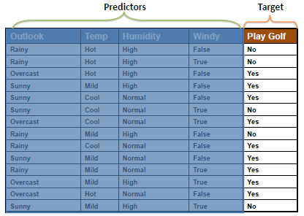
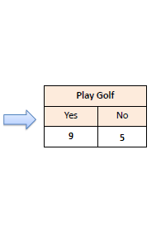
ZeroR Example
●
"Play Golf = Yes" is the ZeroR model for the following dataset with an accuracy of 0.64
Notes:
For any future input (overcaset, hot, normal, false), the model will always be guessed as of type yes

Slide 4
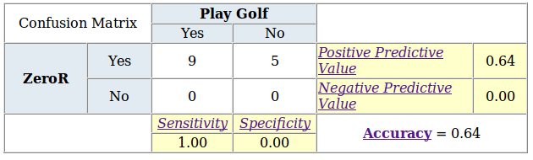
ZeroR Model Evaluation
●
The following Confusion Matrix shows that ZeroR only predicts the majority class correctly
As mentioned before, ZeroR is only useful for determining a baseline performance for other classification methods
●
Metrics definition
Notes:
ZeroR always predicts yes. We build confusion matrix to evaluate the performance of classifier.

Slide 5
The OneR Classifier

Slide 6
OneR
●
OneR, short for "One Rule", is a simple, yet accurate, classification algorithm
How it works:
It generates one rule for each predictor in the data, then selects the rule with the smallest total error as its "one rule"
To create a rule for a predictor, we construct a frequency table for each predictor against the target
It has been shown that OneR produces rules only slightly less accurate than state-of-the-art classification algorithms while producing rules that are simple for humans to interpret
●
●
●
Notes:
OneR uses one predictor(ONE RULE)for classification. Rules are simple because it uses one predictor.
if predictor is numerical, then tranform it to cateogrical to build a frequency table

Slide 7
OneR Algorithm
For each predictor,
For each value of that predictor, make a rule as follows; Count how often each value of target (class) appears Find the most frequent class
Make the rule assign that class to this value of the
predictor
Calculate the total error of the rules of each predictor Choose the predictor with the smallest total error

Slide 8
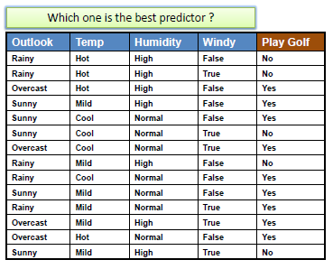
Example
●
Finding the best predictor with the smallest total error using OneR algorithm based on related frequency tables
To measure the total error, we build confusion matrix for the classifier

Slide 9
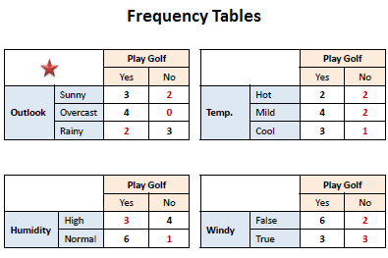
Example
Notes:
If we build a confusion matrix, the outlook attribute will give the highest accuracy.

Slide 10
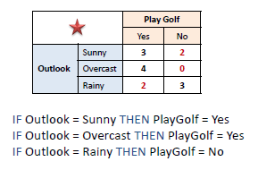
The best predictor is:

Slide 11
Predictors Contribution
●
Simply, the total error calculated from the frequency tables is the measure of each predictor contribution
A low total error means a higher contribution to the predictability of the model.
We build confusion matrix for each predictor to measure its contribution in Predictability of classifier.
●

Slide 12
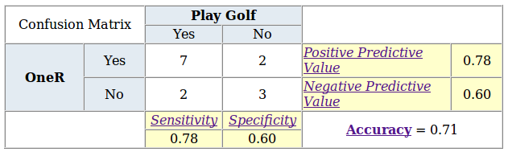
Model Evaluation
●
The following confusion matrix shows significant predictability power
OneR does not generate score or probability, which means evaluation charts (Gain, Lift, K-S and ROC) are not applicable
●
Notes:
Actual values vs Predicted values. Compute the accuracy for each predictor using confusion matrix, and choose the one with the highest accuracy.
In our case,it will be outlook attribute

Slide 13
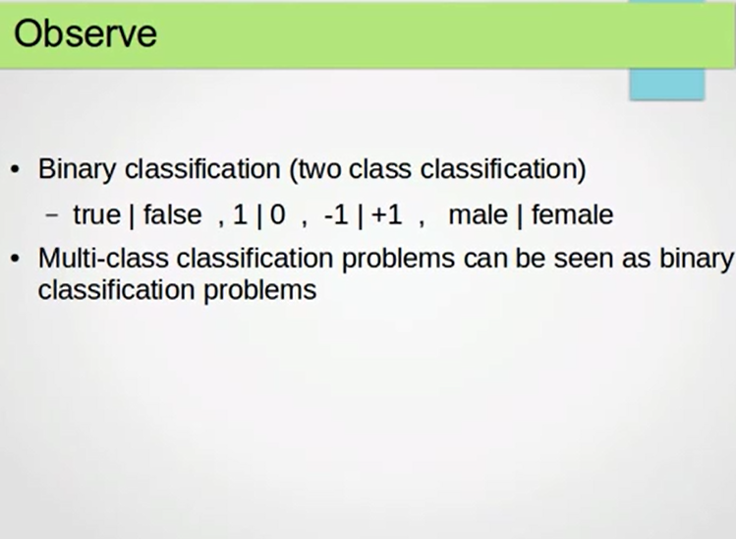
Notes:
Binary classification are problems where we have 2 classes. Multi-class problem can be reduced to binary class problem. Such as one against all approach
Reduce muti-class to binary, a unified approach

Slide 14
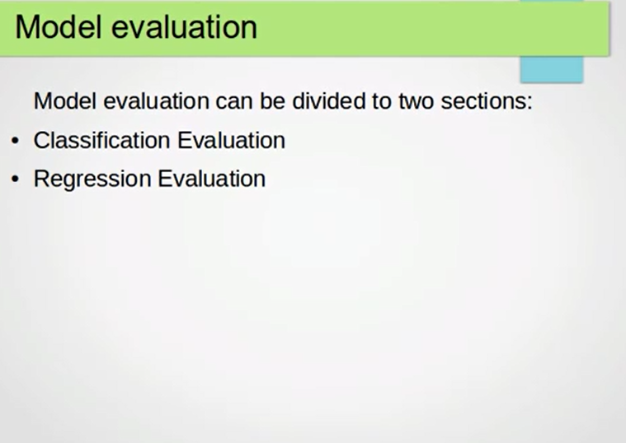
Notes:
We will be evaluating classification models and regression models.
In classification models, We will cover evaluations methods for binary classification: BC are problems where we have deal with 2 classes

Slide 15
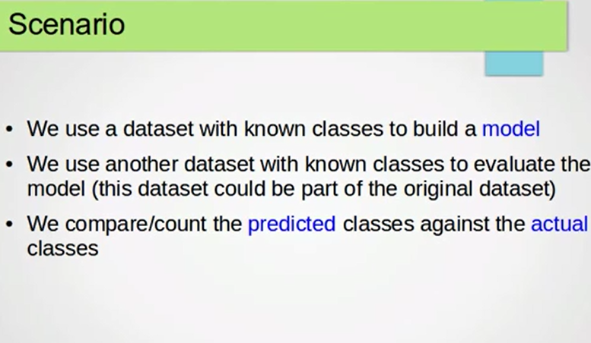
Notes:
We split the original data set into two or three parts: training data 2 validation data set 2 evaluation/test data set
Strategies for model evaluation: hold out and cross validation
Actual classes are the ones in the original data set. Predicted classes are one predicted by the model.

Slide 16
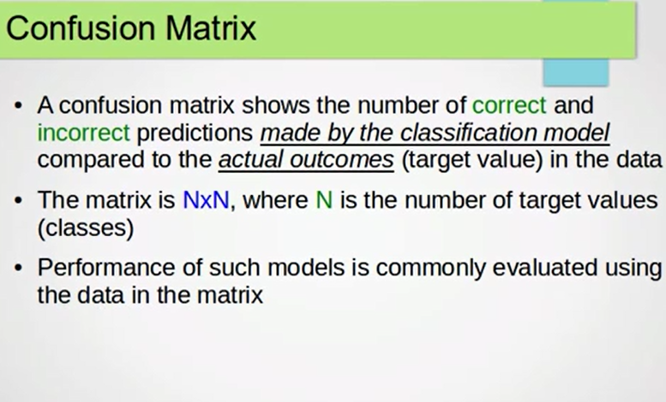
Confusion Matrix is one of the common approaches used for evaluating a model(classifier).
Notes:
5*5 matrix if we have 5 classes. In our case, we have 2*2 matrix as we have 2 classes.

Slide 17

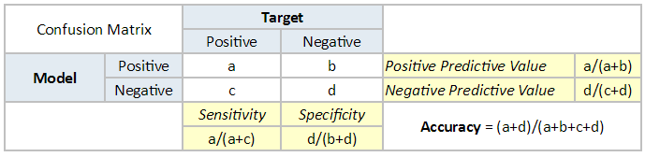
Notes:
Target or actual classes
a is No of instances which are actually positive and predicted by model as positive.
b is No of instances which are actually negative but they were predicted as positive by classifier.
positive predicted to be positive is a
negative predicted to be positive is b
positive predicted to be negative is c
negative predicted to be negative is d
a is positive predicted to be positive is correct

Slide 18
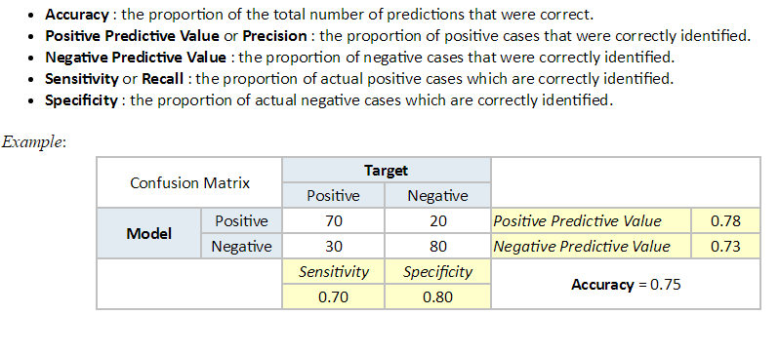
ZeroR

